Slide 1
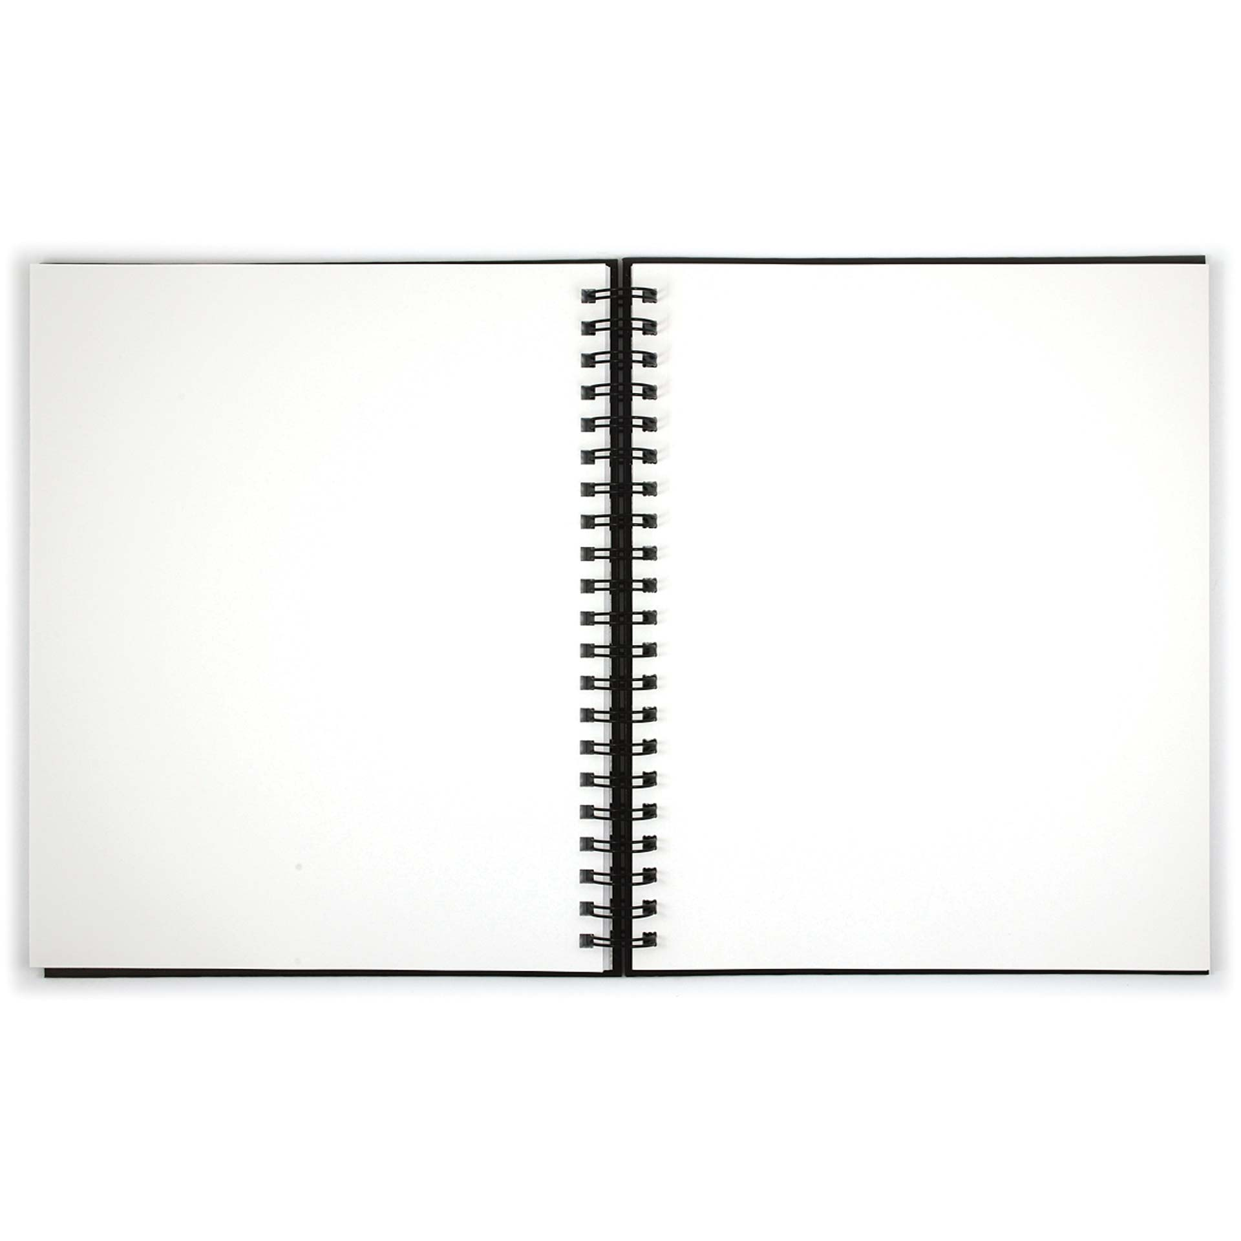
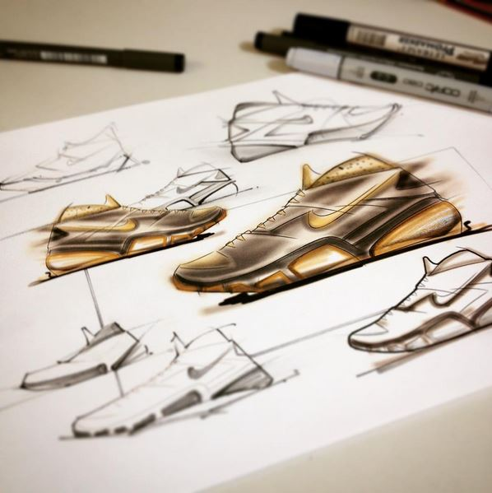
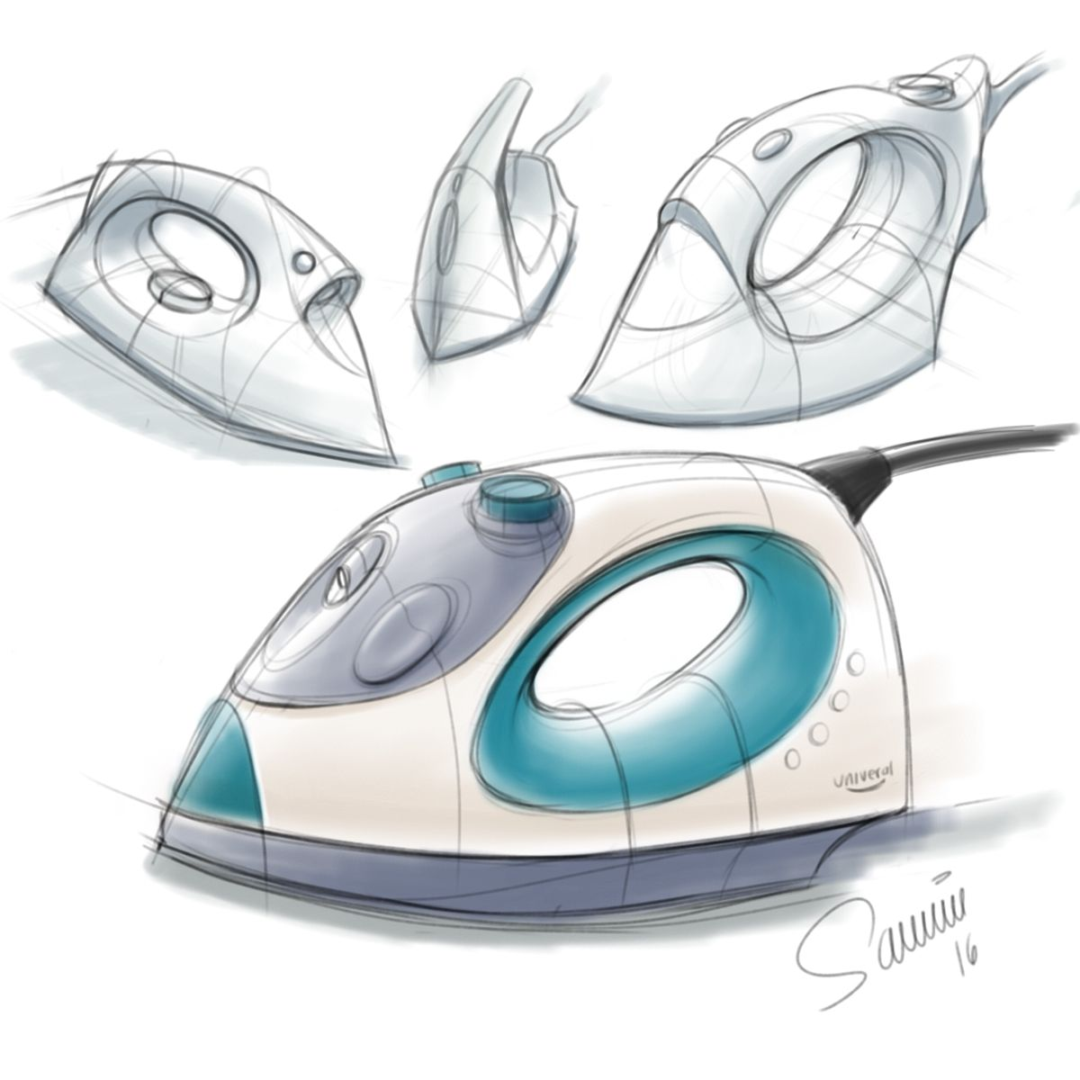
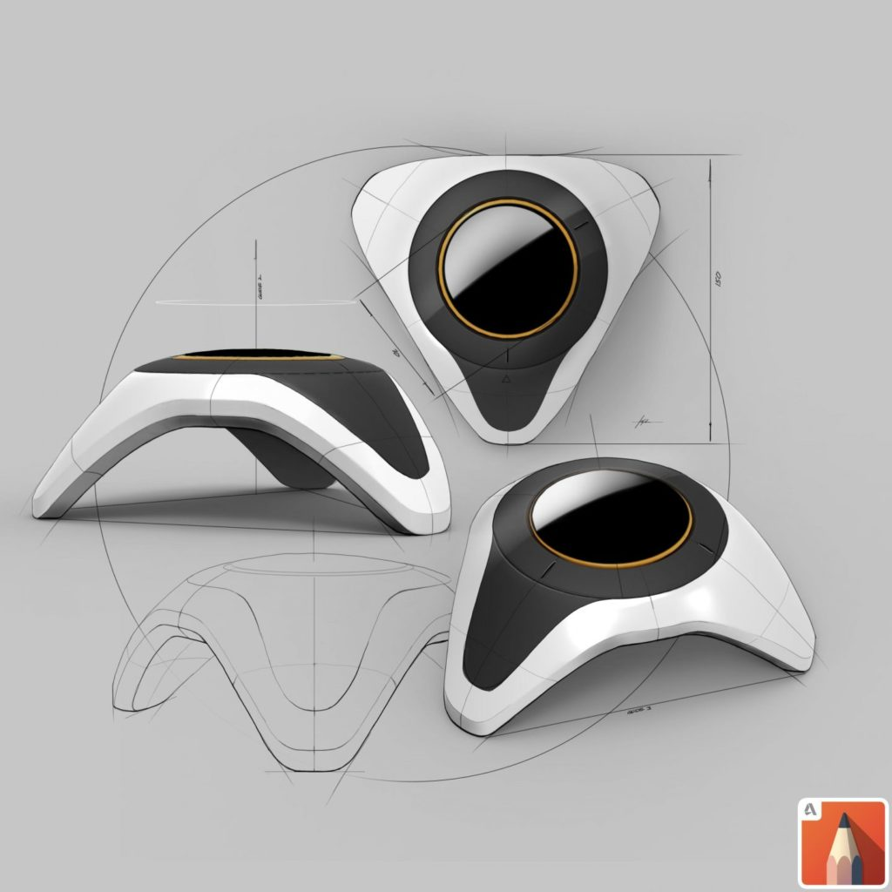
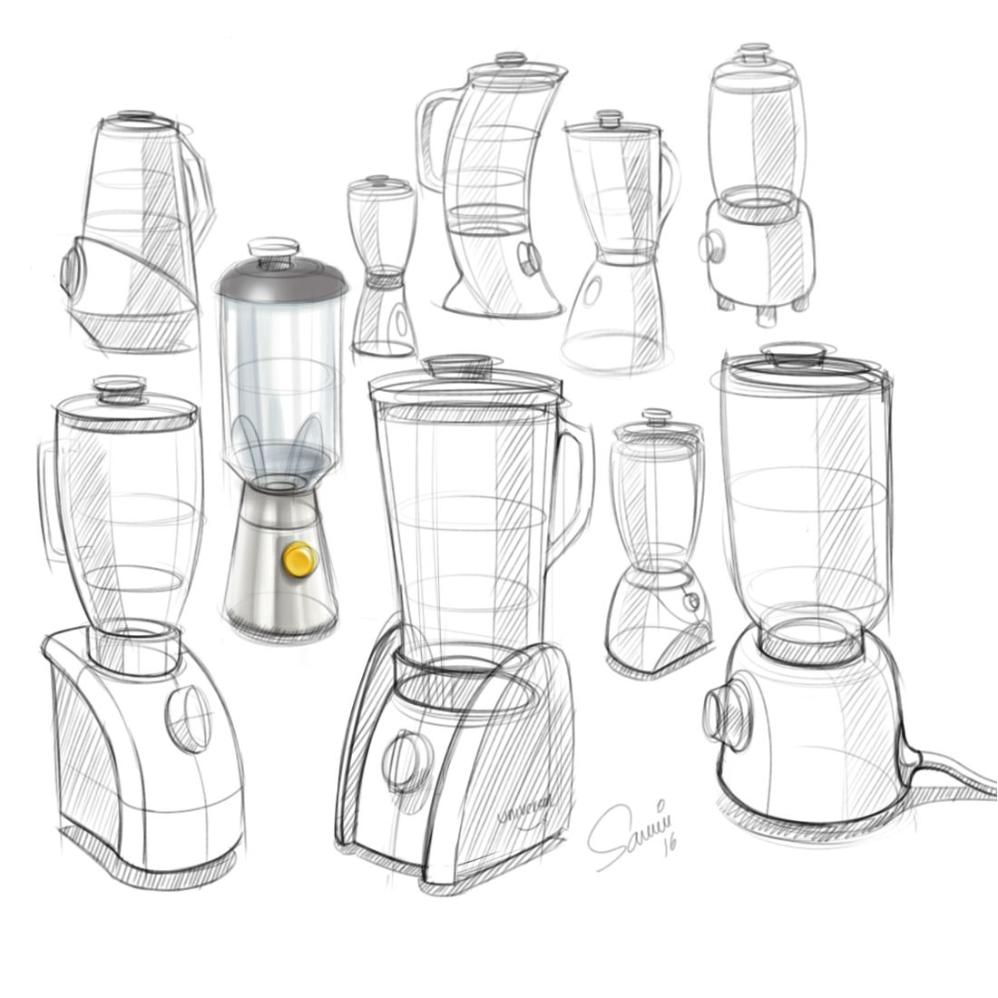
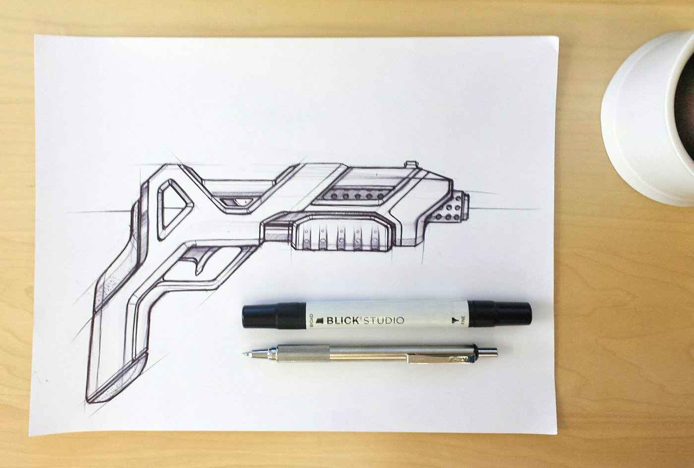
Year 11 to Year 12 A Level DT Transition Project
WHAT?
Create a visual sketch journal which aims to develop design skill a small A5 or A4 sketchbook.
HOW?
Use a combination techniques and media to illustrate the suggested themes using a range of materials, techniques & processes.
WHY?
To develop & refine your observation and technical drawing skills by looking more closely at things around you that you see everyday, & to explore skills in creating drawings for design.

Slide 2
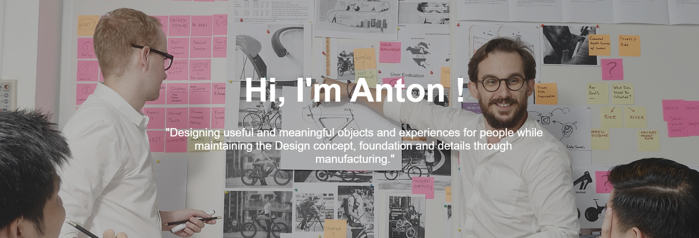
What do I need?
An A4/A5 notebook / sketchbook / paper
A mobile phone / laptop / tablet with access to youtube
A Pencil / sketch pencils
Biro pen
Ballpoint pen
Rubber
Sharpener
WEEK 1
Anton Ruckman is a Multidisciplinary Designer who has launched video tutorials to teach you all the basics you need to know to become an elegant and skilled design sketcher.
https://antonruckman.myportfolio.com/story
Each week follow Anton’s ‘Beginners’ tutorials and recreate his samples in a sketchbook/notebook of your own.
Once complete, you will then complete a sketch a week challenge between now and the summer holidays.
Upload photos of your progress to our instagram account:
Watch the tutorial and copy the techniques demonstrated
LESSON 1: Basic Tools

Slide 3
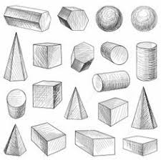
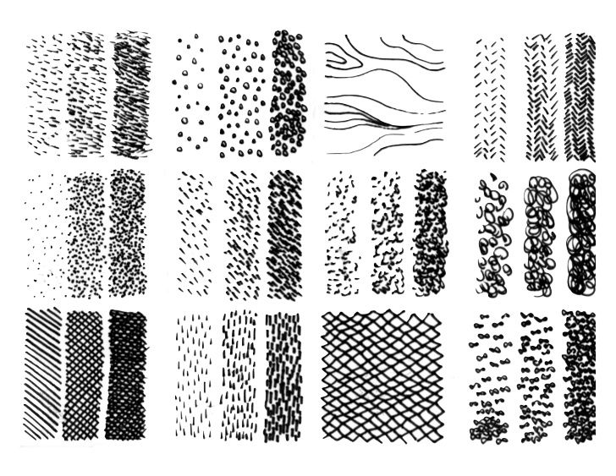
WEEK 2
Watch the tutorial and copy the techniques demonstrated
LESSON 3: Basic Shapes
LESSON 2: Lines
Watch the tutorial and copy the techniques demonstrated
WEEK 1

Slide 4
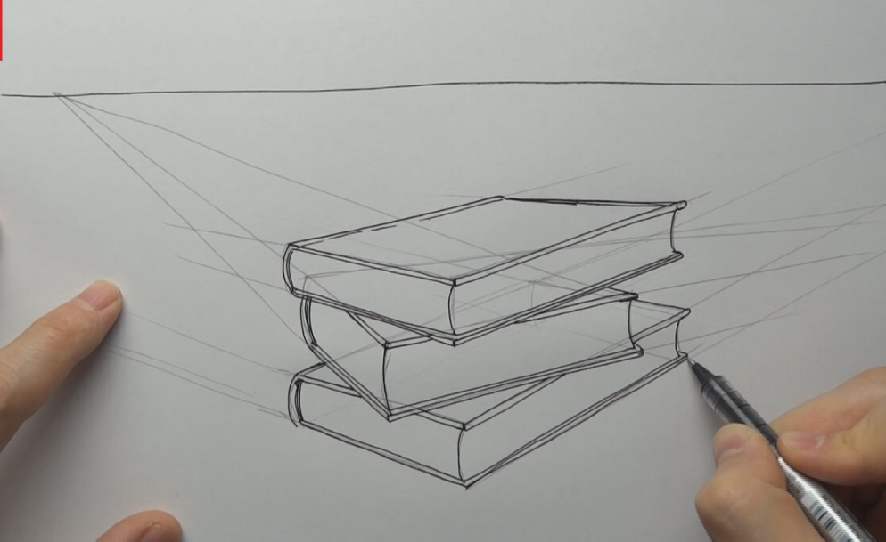
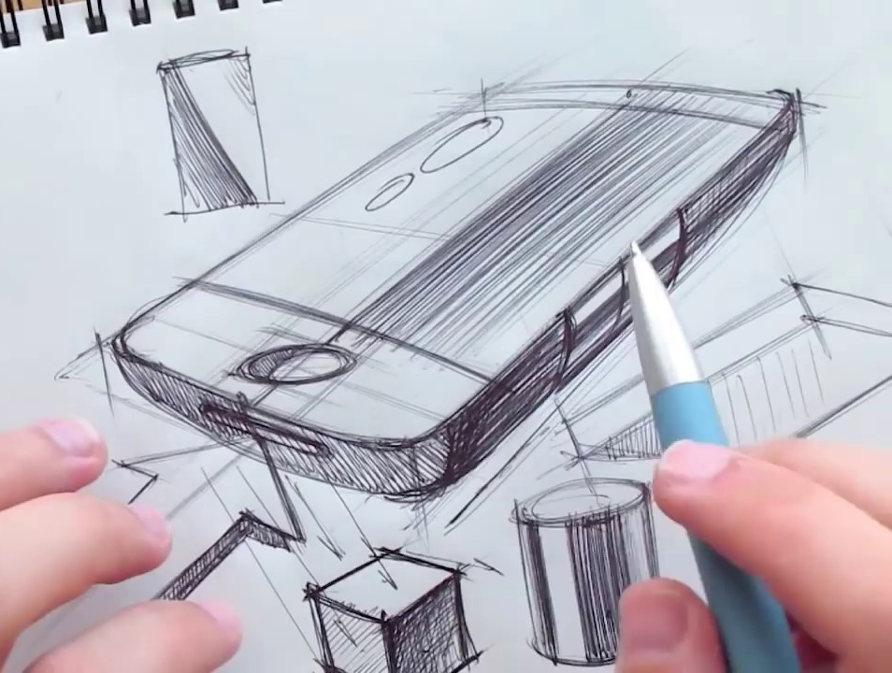
WEEK 3
Watch the tutorial and copy the techniques demonstrated
LESSON 5: Two Point Perspective
LESSON 4: One Point Perspective
Watch the tutorial and copy the techniques demonstrated
WEEK 2

Slide 5
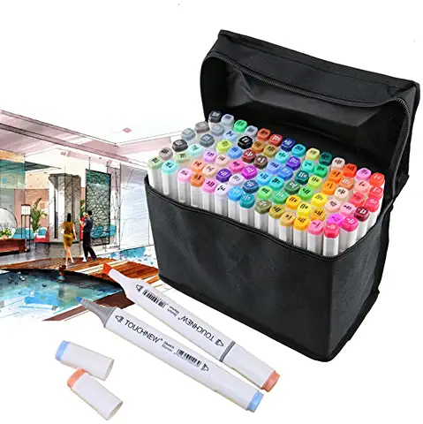
What can I buy instead?
https://www.amazon.co.uk/s?k=alcohol+marker+pens&crid=VOMWU11WJJO8&sprefix=alcohol+ma%2Caps%2C153&ref=nb_sb_ss_i_2_10
WEEK 4
Watch the tutorial and copy the techniques demonstrated
LESSON 7: Basic Render
LESSON 6: Three Point Perspective
Watch the tutorial and copy the techniques demonstrated
WEEK 3

Slide 6
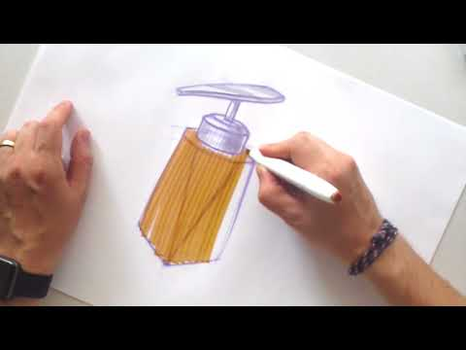
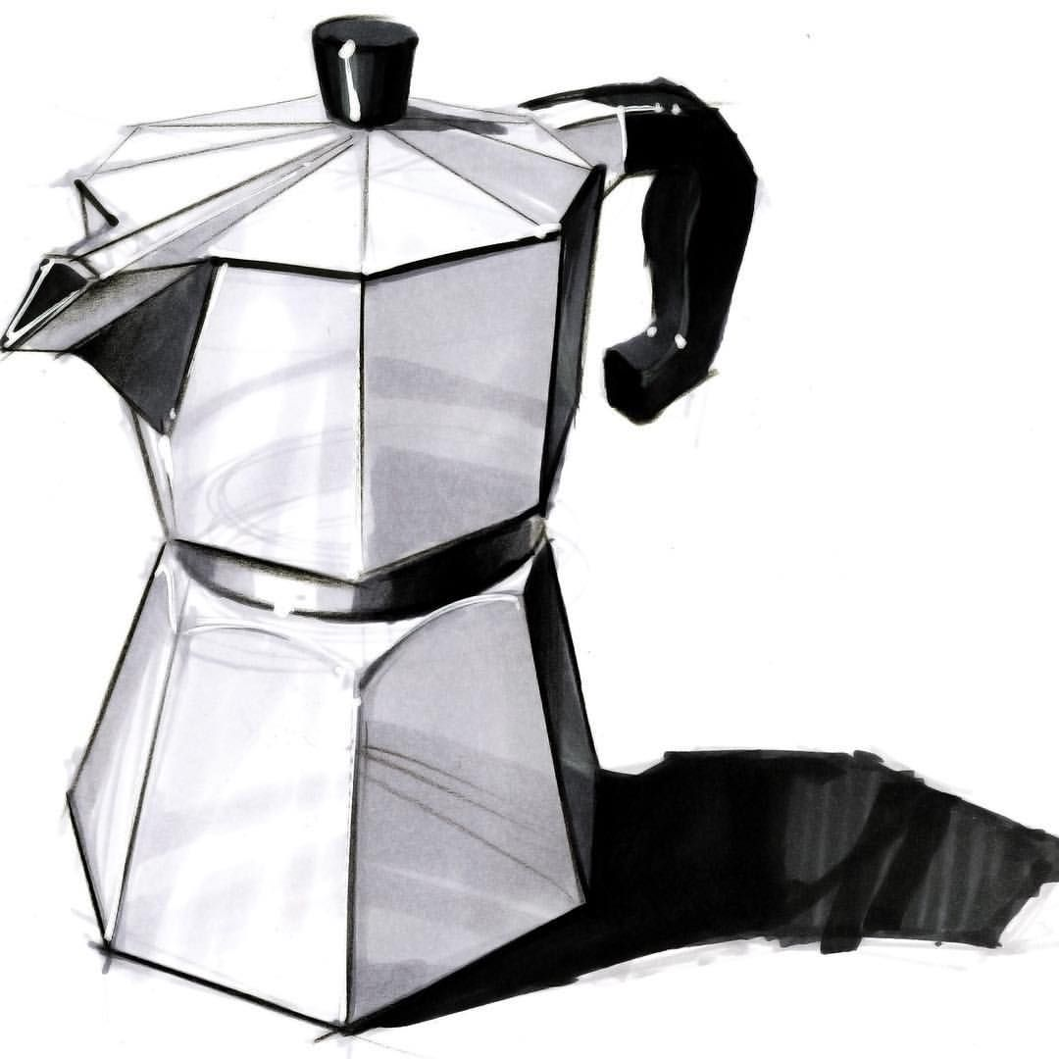
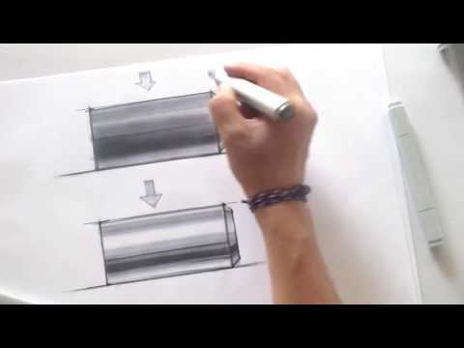
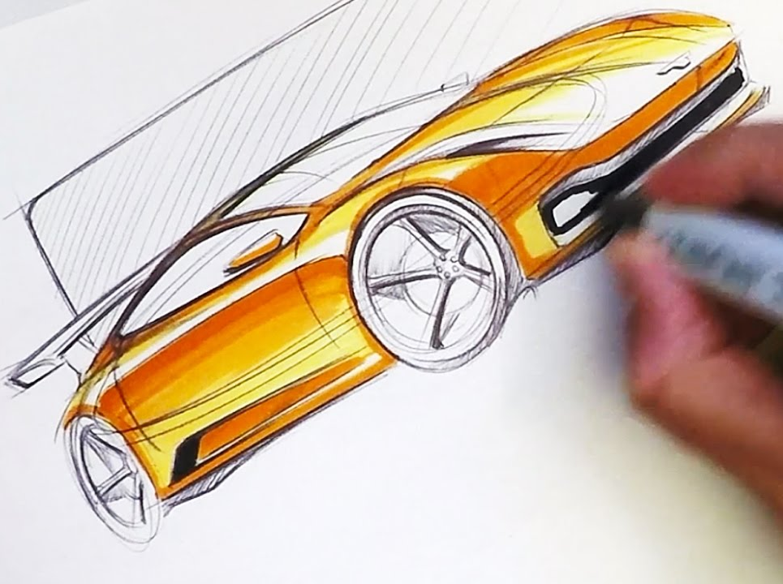
WEEK 5
Watch the tutorial and copy the techniques demonstrated
LESSON 9: How to render a metal cylinder
LESSON 8: How to sketch with markers
Watch the tutorial and copy the techniques demonstrated
WEEK 4

Slide 7
SKETCH A WEEK TASK
1
WEEK 6
ONE
POINT PERSPECTIVE

Slide 8
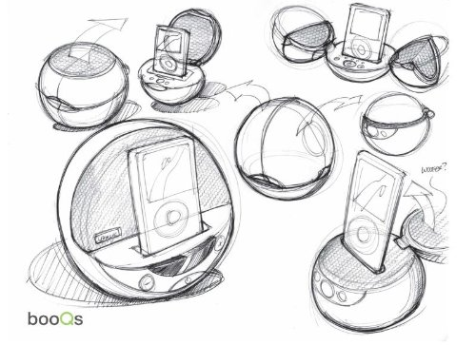
SKETCH A WEEK TASK
INSPIRATION PAGE
Based on ONE POINT PERSPECTIVE
Using your learning from
Lesson 04: One Point Perspective
sketch a range of baskets / laundry basket designs.
Fill a page in your sketchbook, notebook or paper.
HAVE A GO:
Have a go at using line techniques to present your ideas creatively.
Remember to upload your work to:
TIP: Watch lesson 04 again if you cannot remember how to present your sketches in one point perspective.

Slide 9
SKETCH A WEEK TASK
2
WEEK 7
TWO
POINT PERSPECTIVE

Slide 10
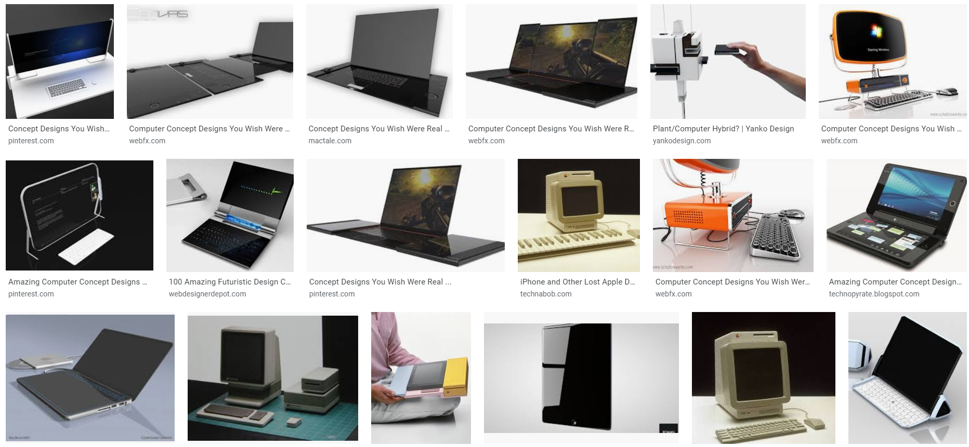
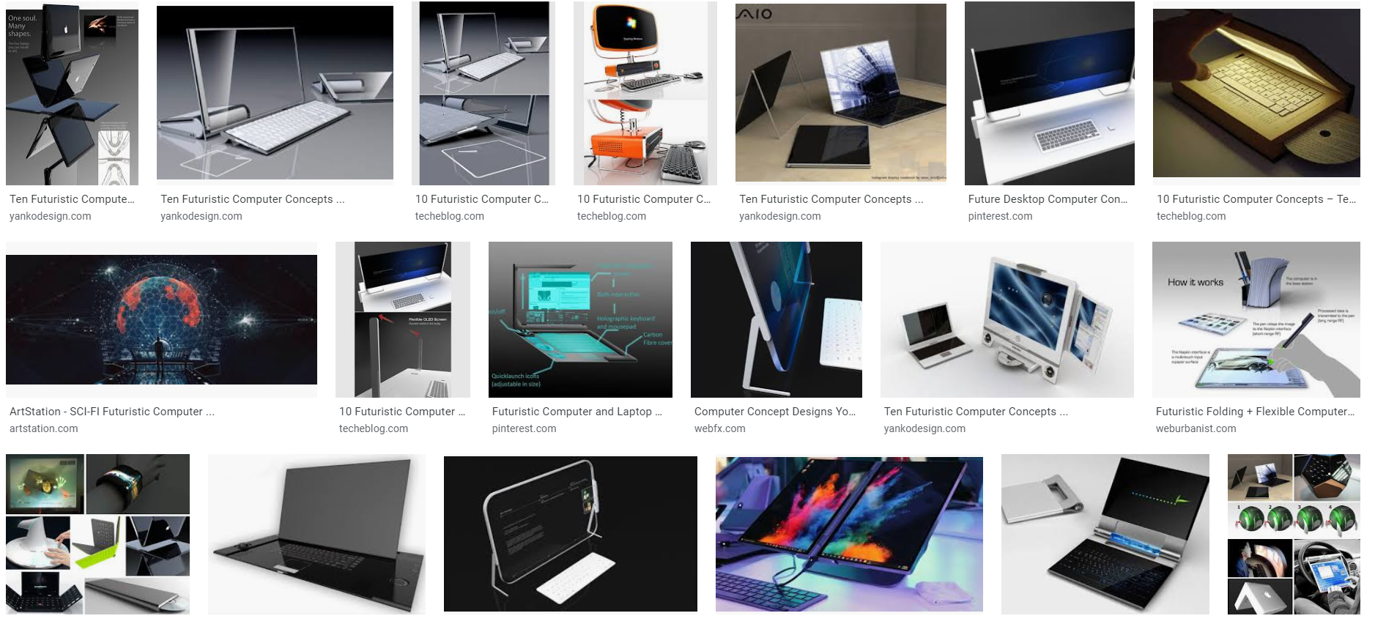
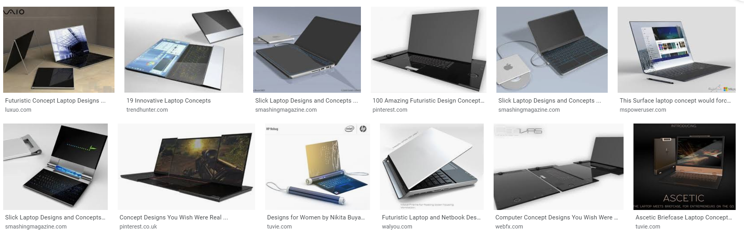
SKETCH A WEEK TASK
INSPIRATION PAGE
Based on ONE POINT PERSPECTIVE
Using your learning from
Lesson 05: Two Point Perspective
sketch a range of computers and laptops.
Fill a page in your sketchbook, notebook or paper.
HAVE A GO:
Have a go at using colour to render your ideas creatively.
Remember to upload your work to:
TIP: Watch lesson 05 again if you cannot remember how to present your sketches in one point perspective.

Slide 11
SKETCH A WEEK TASK
3
WEEK 8
THREE
POINT PERSPECTIVE

Slide 12
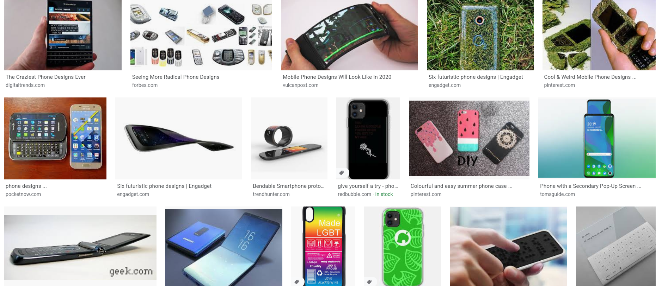
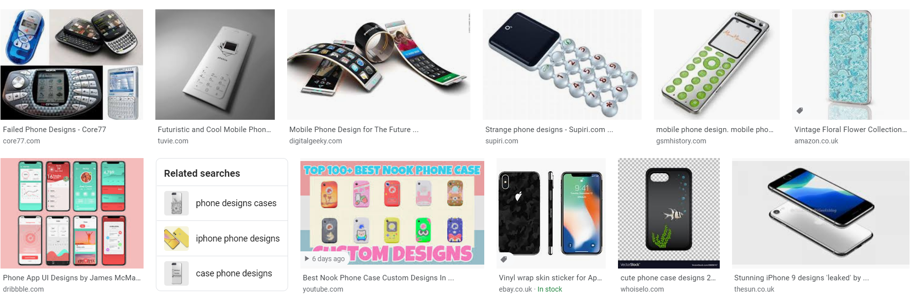
SKETCH A WEEK TASK
INSPIRATION PAGE
Based on ONE POINT PERSPECTIVE
Using your learning from
Lesson 06: Three Point Perspective
sketch a range of phones and tablets.
Fill a page in your sketchbook, notebook or paper.
HAVE A GO:
Have a go at using colour to render your ideas creatively.
Remember to upload your work to:
TIP: Watch lesson 06 again if you cannot remember how to present your sketches in one point perspective.

Slide 13
SKETCH A WEEK TASK
4
WEEK 9
ONE
POINT PERSPECTIVE

Slide 14
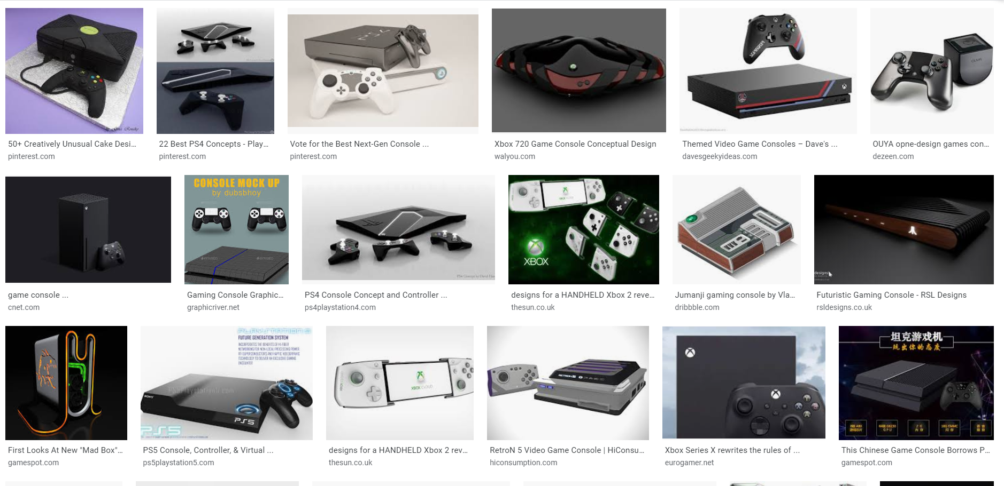
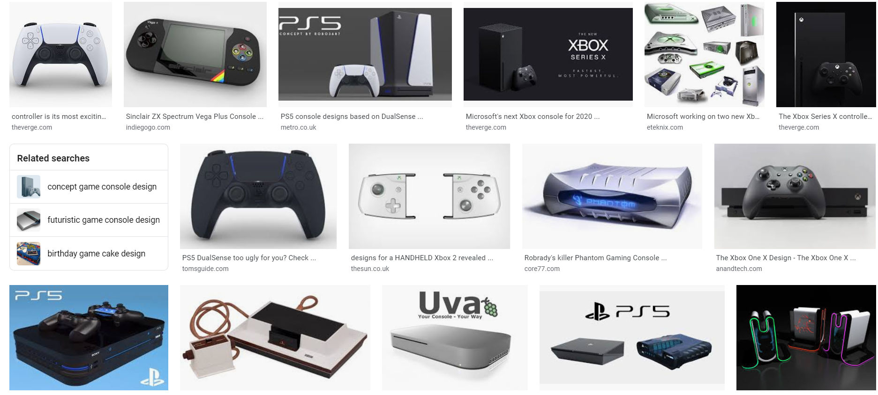
SKETCH A WEEK TASK
INSPIRATION PAGE
Based on ONE POINT PERSPECTIVE
Using your learning from
Lesson 04: One Point Perspective
sketch a range of
game console designs.
Fill a page in your sketchbook, notebook or paper.
HAVE A GO:
Have a go at using colour to render your ideas creatively.
Remember to upload your work to:
TIP: Watch lesson 04 again if you cannot remember how to present your sketches in one point perspective.

Slide 15
SKETCH A WEEK TASK
5
WEEK 10
TWO
POINT PERSPECTIVE

Slide 16
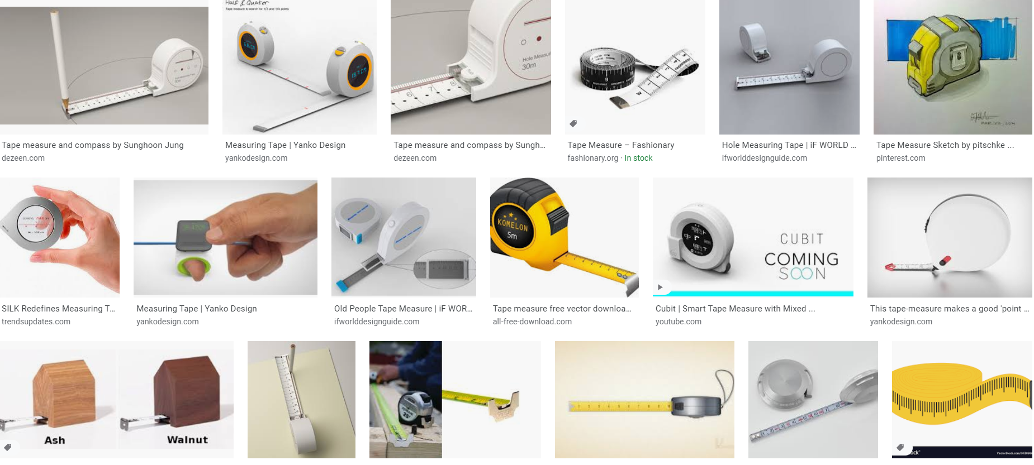
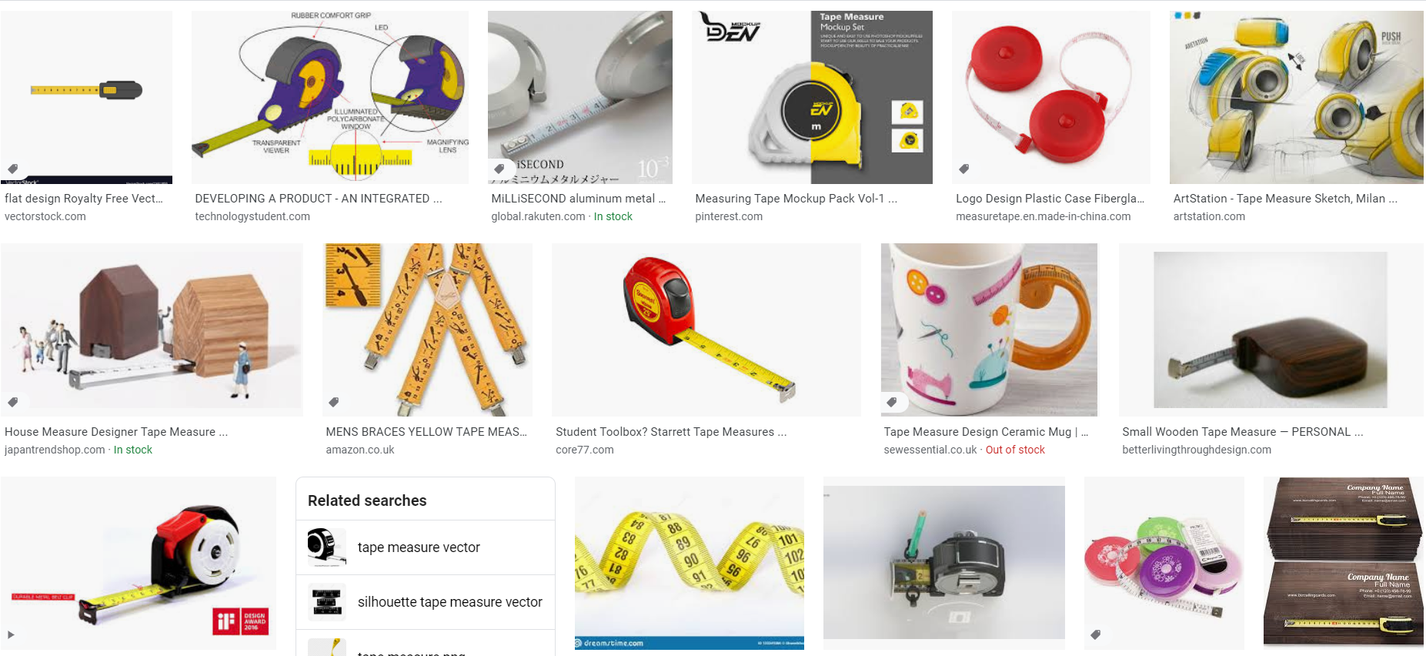
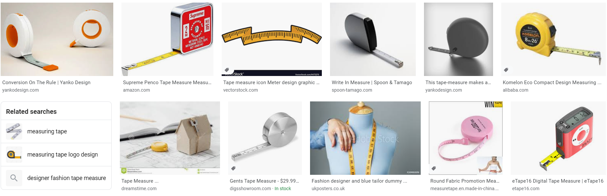
SKETCH A WEEK TASK
INSPIRATION PAGE
Based on ONE POINT PERSPECTIVE
Using your learning from
Lesson 05: Two Point Perspective
sketch a range of
tape measures.
Fill a page in your sketchbook, notebook or paper.
HAVE A GO:
Have a go at using colour to render your ideas creatively.
Remember to upload your work to:
TIP: Watch lesson 05 again if you cannot remember how to present your sketches in one point perspective.

Slide 17
SKETCH A WEEK TASK
6
WEEK 11
THREE
POINT PERSPECTIVE

Slide 18
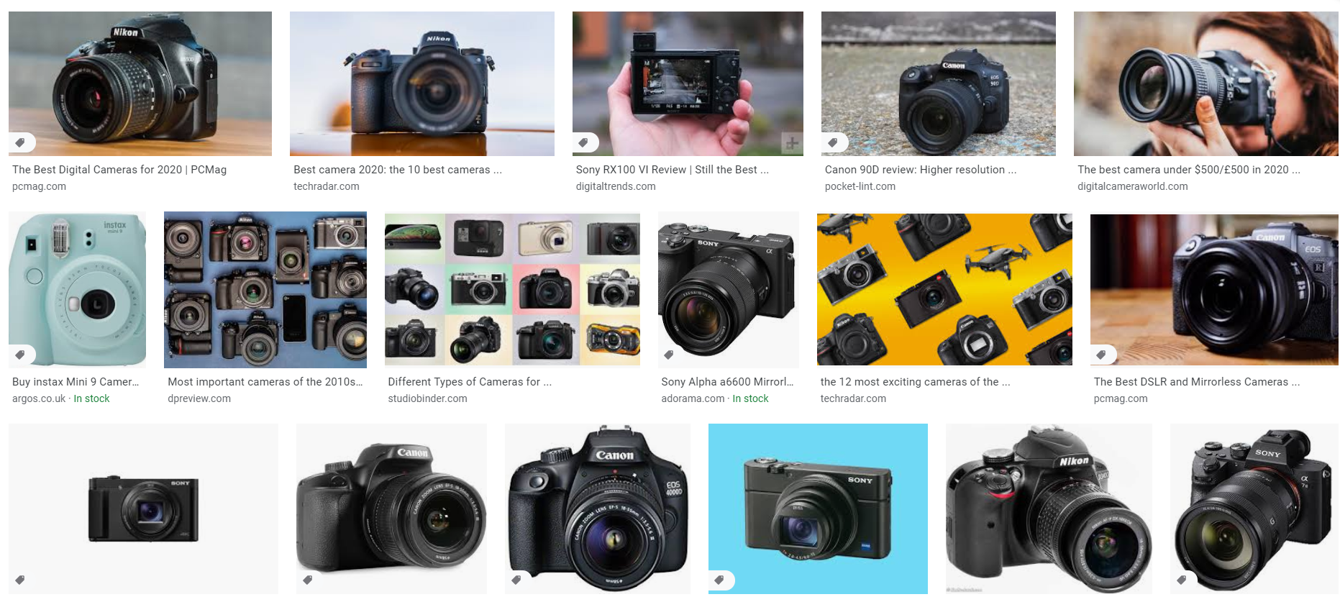
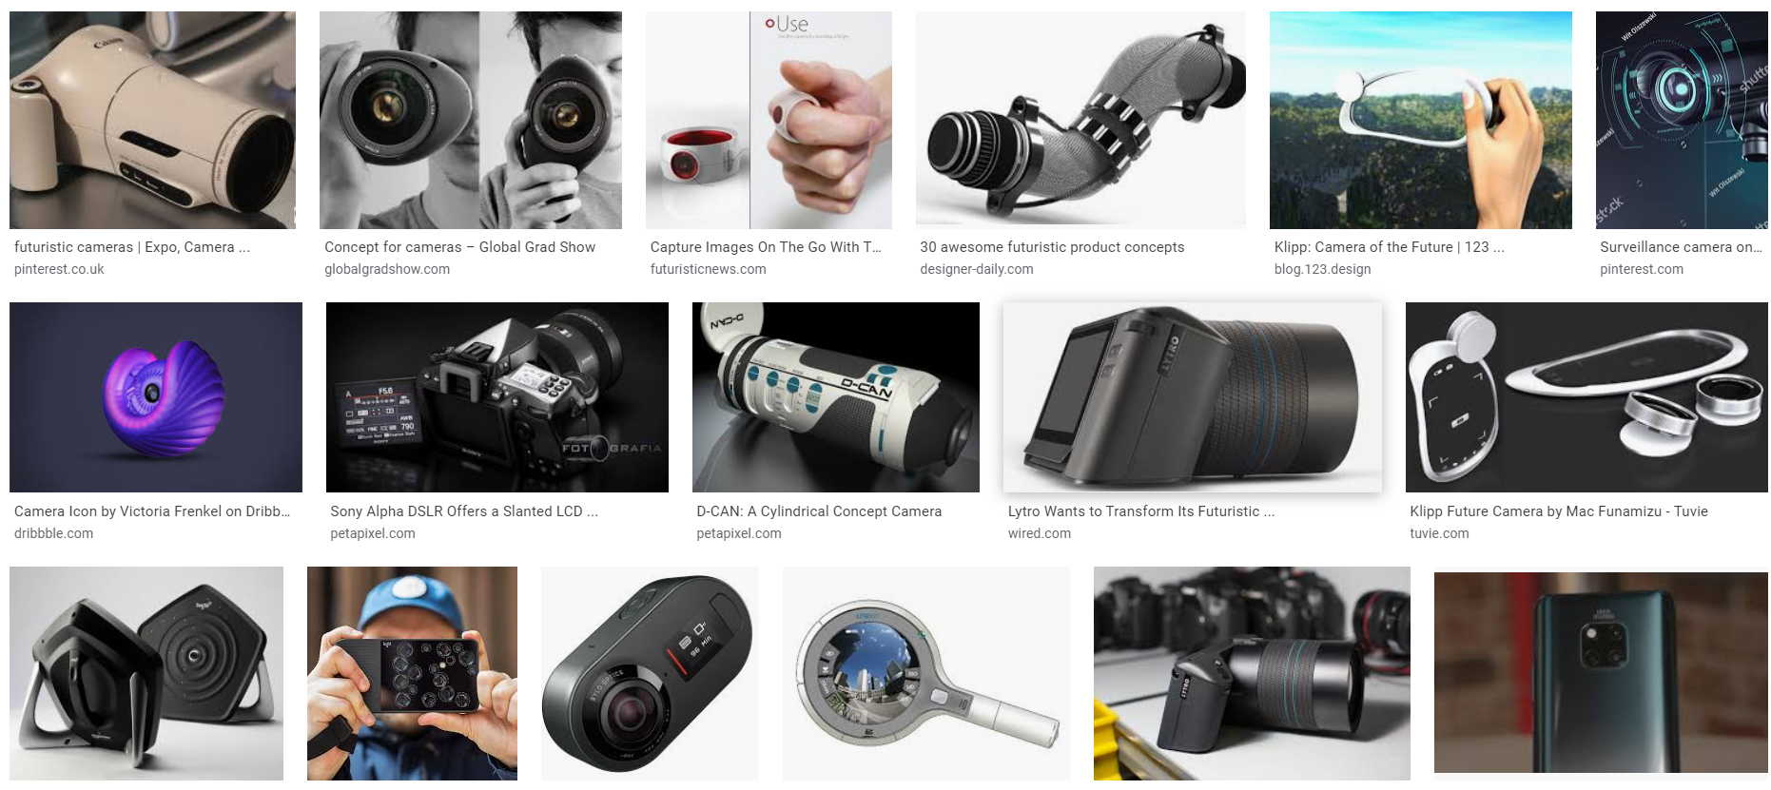
SKETCH A WEEK TASK
INSPIRATION PAGE
Based on ONE POINT PERSPECTIVE
Using your learning from
Lesson 06: Three Point Perspective
sketch a range of
cameras.
Fill a page in your sketchbook, notebook or paper.
HAVE A GO:
Have a go at using colour to render your ideas creatively.
Remember to upload your work to:
TIP: Watch lesson 06 again if you cannot remember how to present your sketches in one point perspective.

Slide 19
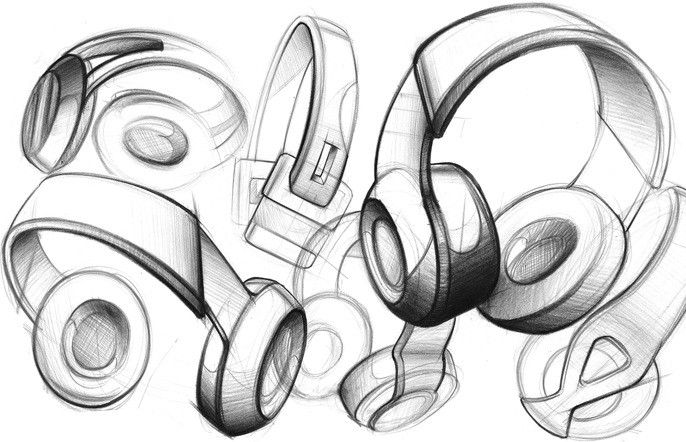
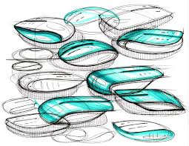
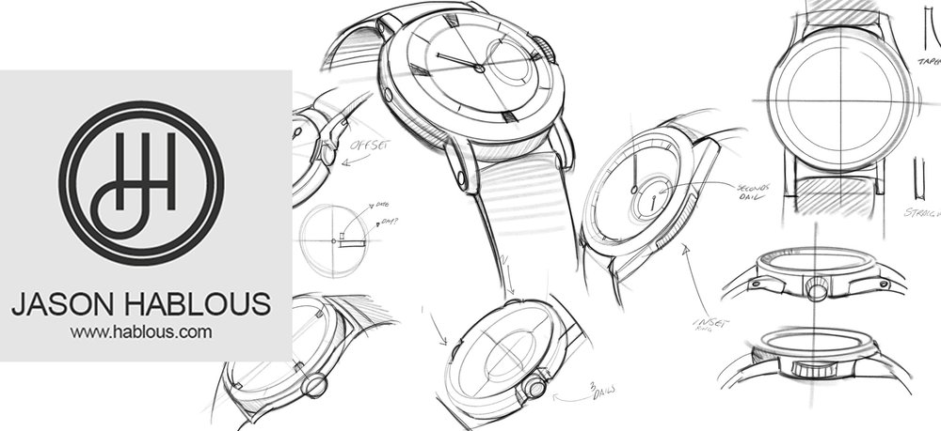
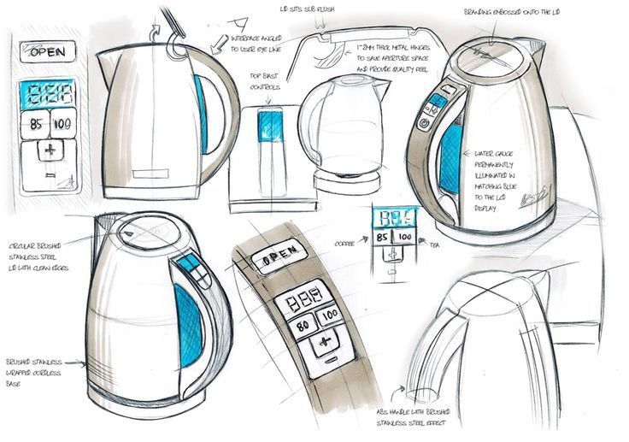
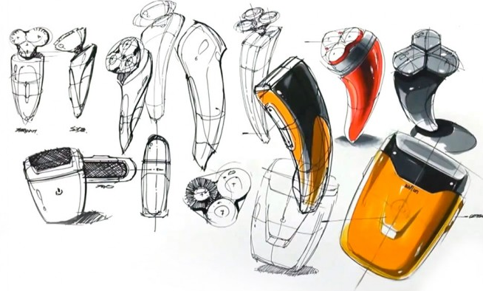
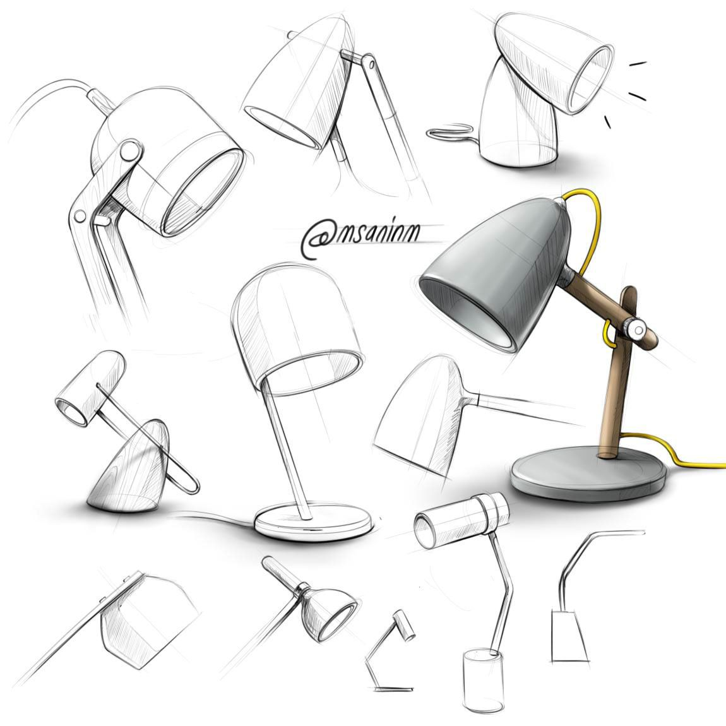
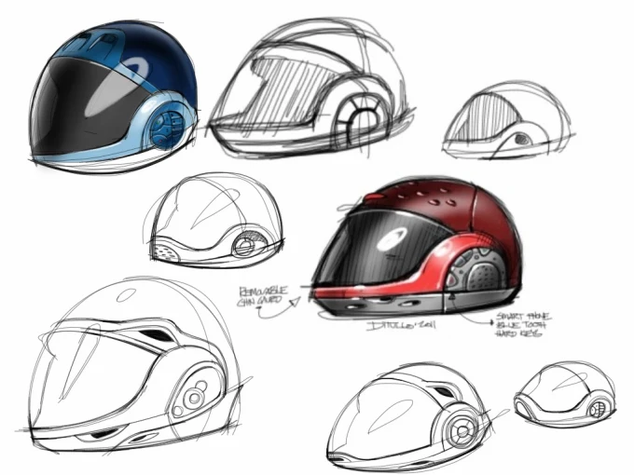
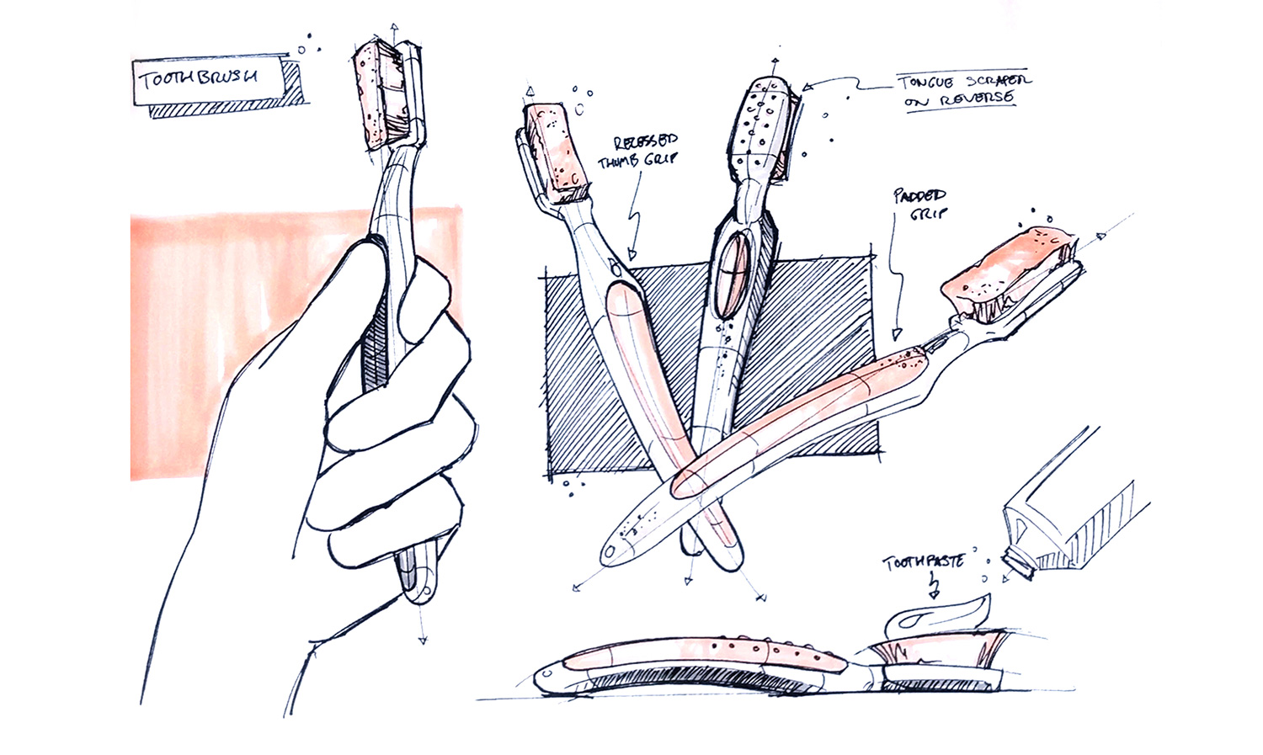
SUMMER CHALLENGE
WEEK 12-18
Have a go at drawing products from the list below in ONE of the perspective methods learned.
Headphones
Toothbrushes
Lamps
Kettles
Vases
Watches
Suitcases
Stationary
Pans
Electric shavers
Peelers
Knives
Computer mouse
Helmets
Chairs
Printers
Bags
Trainers
Games Controllers
Remote Controls
Glasses
Iron

